Slide 1
AWS

Slide 2
AWS Monitoring CloudWatch, CloudTrail

Slide 3
Amazon CloudWatch Metrics
• CloudWatch provides metrics for every services in AWS
• Metric is a variable to monitor (CPUUtilization, NetworkIn…)
• Metrics belong to namespaces
• Dimension is an attribute of a metric (instance id, environment, etc…).
• Up to 30 dimensions per metric
• Metrics have timestamps
• Can create CloudWatch dashboards of metrics
• Can create CloudWatch Custom Metrics (for the RAM for example)

Slide 4
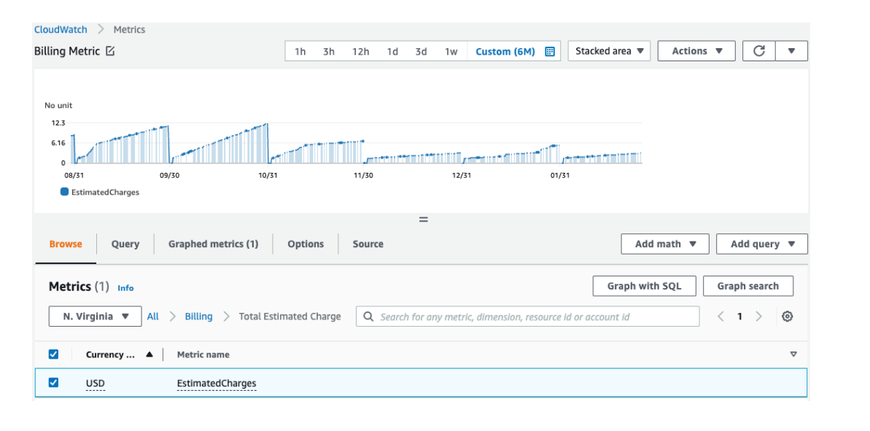
Example: CloudWatch Billing metric

Slide 5
Important Metrics • EC2 instances: CPU Utilization, Status Checks, Network
Default metrics every 5 minutes
Option for Detailed Monitoring ($$$): metrics every 1 minute
• EBS volumes: Disk Read/Writes
• S3 buckets: BucketSizeBytes, NumberOfObjects, AllRequests
• Billing: Total Estimated Charge (only in us-east-1)
• Service Limits: how much you’ve been using a service API
• Custom metrics: push your own metrics

Slide 6
CloudWatch Logs
• Log groups: arbitrary name, usually representing an application
• Log stream: instances within application / log files / containers
• Can define log expiration policies (never expire, 1 day to 10 years…)
• CloudWatch Logs can send logs to:
Amazon S3 (exports)
AWS Lambda
OpenSearch
• Logs are encrypted by default
• Can setup KMS-based encryption with your own keys

Slide 7
Amazon CloudWatch Logs
• SDK, CloudWatch Logs Agent, CloudWatch Unified Agent
• Elastic Beanstalk: collection of logs from application
• ECS: collection from containers
• AWS Lambda: collection from function logs
• VPC Flow Logs: VPC specific logs
• API Gateway
• CloudTrail based on filter
• Route53: Log DNS queries

Slide 8
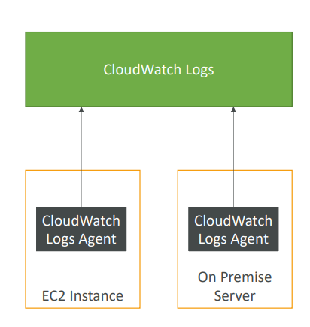
CloudWatch Logs for EC2
• By default, no logs from your EC2
instance will go to CloudWatch
• You need to run a CloudWatch agent on
EC2 to push the log files you want
• Make sure IAM permissions are correct
• The CloudWatch log agent can be
setup on-premises too

Slide 9
Amazon CloudWatch Alarms
• Alarms are used to trigger notifications for any metric
• Various options (sampling, %, max, min, etc…)
• Alarm States:
OK
INSUFFICIENT_DATA
ALARM
• Period:
Length of time in seconds to evaluate the metric
High resolution custom metrics: 10 sec, 30 sec or multiples of 60 sec

Slide 10
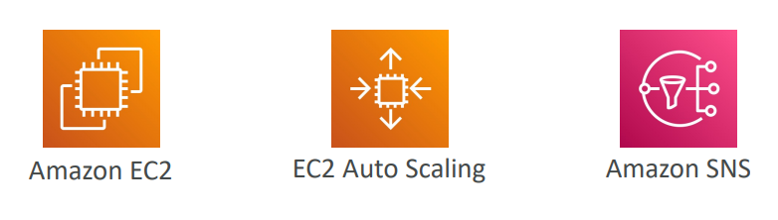
CloudWatch Alarm Targets
• Stop, Terminate, Reboot, or Recover an EC2 Instance
• Trigger Auto Scaling Action
• Send notification to SNS (from which you can do pretty much anything)

Slide 11
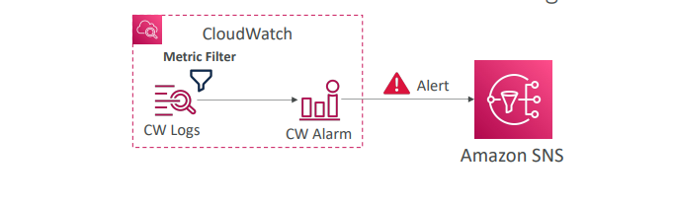
CloudWatch Alarm: good to know
• Alarms can be created based on CloudWatch Logs Metrics Filters
• To test alarms and notifications, set the alarm state to Alarm using CLI
aws cloudwatch set-alarm-state --alarm-name "myalarm" --state-value
ALARM --state-reason "testing purposes"

Slide 12
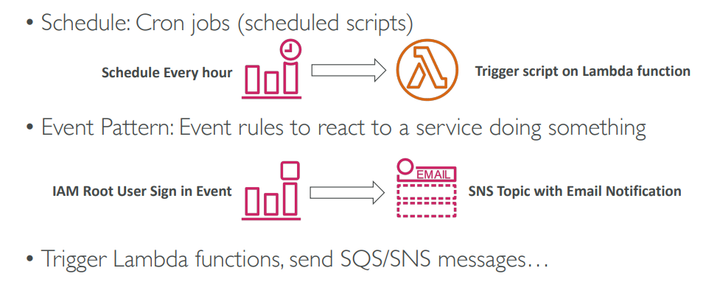
Amazon EventBridge (formerly CloudWatch Events)

Slide 13
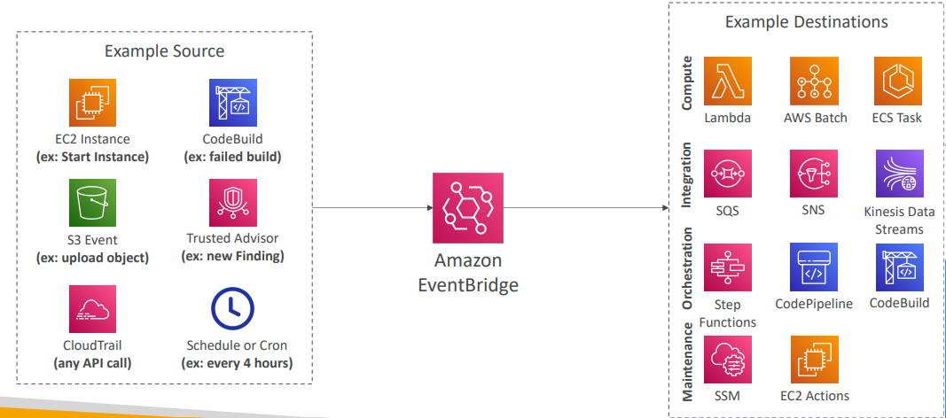
Amazon EventBridge Rules

Slide 14
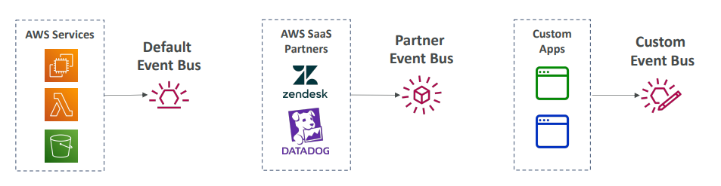
Amazon EventBridge
• Event buses can be accessed by other AWS accounts using Resource-based Policies
• You can archive events (all/filter) sent to an event bus (indefinitely or set period)
• Ability to replay archived events

Slide 15
AWS CloudTrail • Provides governance, compliance and audit for your AWS Account
• CloudTrail is enabled by default!
• Get an history of events / API calls made within your AWS Account by:
Console
SDK
CLI
AWS Services
• Can put logs from CloudTrail into CloudWatch Logs or S3
• A trail can be applied to All Regions (default) or a single Region.
• If a resource is deleted in AWS, investigate CloudTrail first!

Slide 16
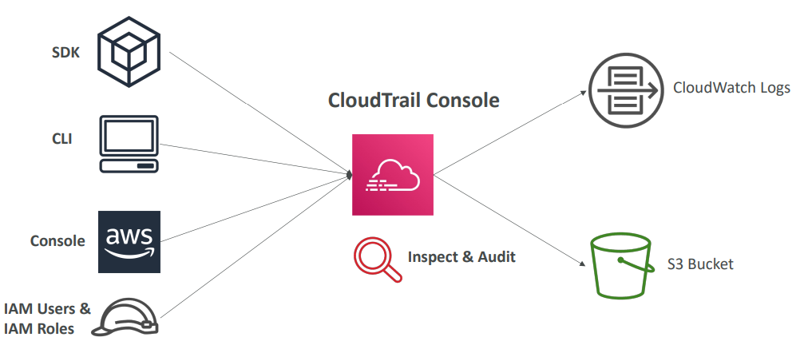
CloudTrail Diagram

Slide 17
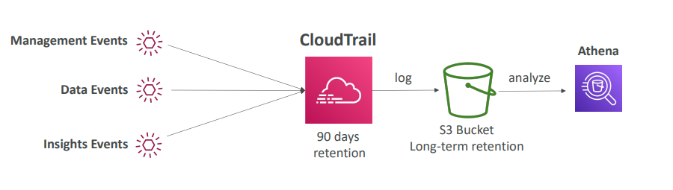
CloudTrail Events Retention
• Events are stored for 90 days in CloudTrail
• To keep events beyond this period, log them to S3 and use Athena

Slide 18
CloudWatch vs CloudTrail
CloudWatch
Performance monitoring (metrics, CPU, network, etc…) & dashboards
Events & Alerting
Log Aggregation & Analysis
CloudTrail
Record API calls made within your Account by everyone
Can define trails for specific resources
Global Service

